Slide 1
UIU Eatery -Cafeteria Management System-

Slide 2
Taiyaba Taskin ID: 011162063
Shifa Chowdhury Iwase ID: 011183003
Md. Jubayer Hossain Sheebly ID:011183017
Md Tarifuzzaman ID: 011191245
Md Sazzad Mazumder ID: 011201285
Our Team

Slide 3
List of Epics & Tasks of Our System
Epics & Tasks:
Registration
User sign up and login
Home page
Register by students for homemade food
Search & Order
Search & choose item
Stock availability
Cart
Payment

Slide 4
List of Epics & Tasks of Our System
Epics & Tasks:
Delivery & Notification
Delivery for faculty & homemade food
Notification about food processes
Ratings & Complains
Review & ratings
Complaint box
Order history

Slide 5
List of Epics & Tasks of Our System
Epics & Tasks
Update & Analysis
Add & update menu items
Admin order monitoring
Current crowd status of cafeteria

Slide 6
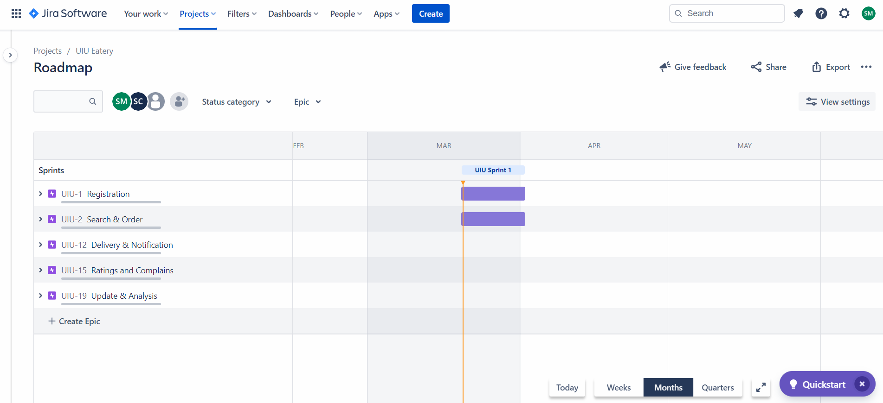
Jira Road Map & Cycle

Slide 7
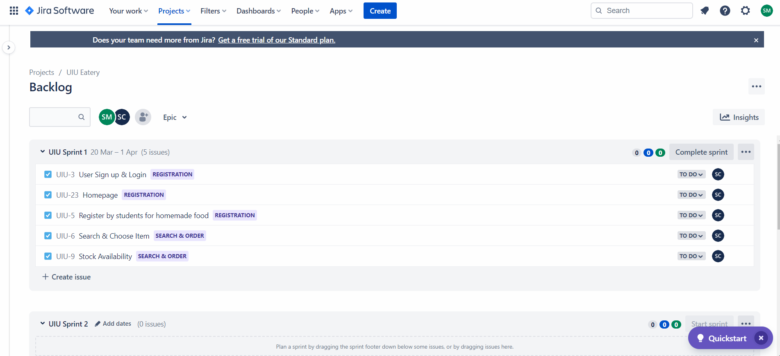
Jira Road Map & Cycle

Slide 8
THANK YOU !

